Slide 1

Welcome to Intro to Hadoop
Presented by:
Jerry Chen
Chris Kim
Jackson Davis

Slide 2
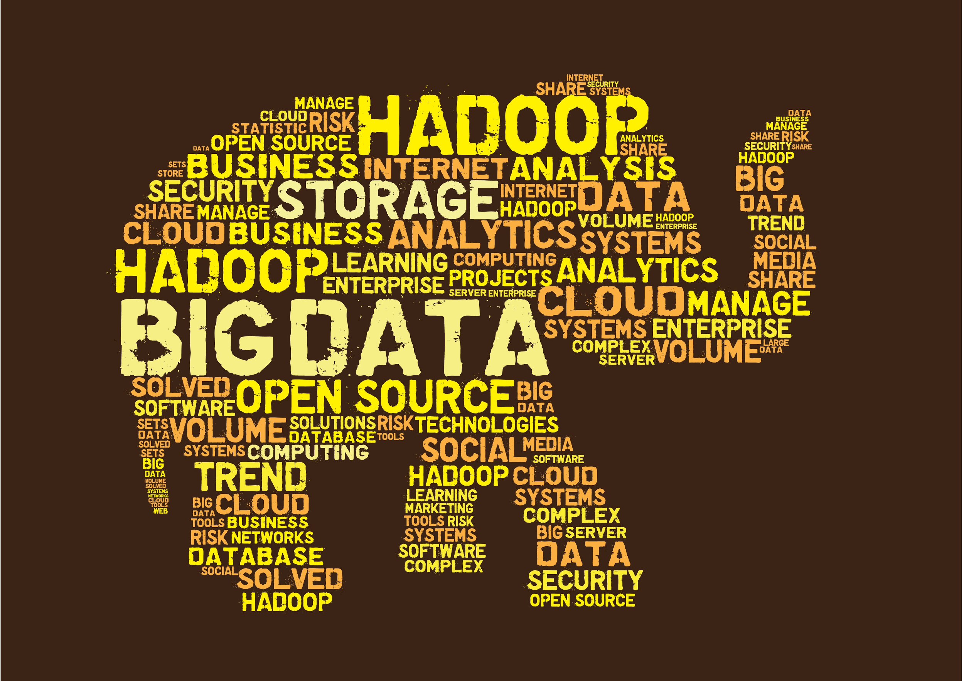
What is the biggest problem today?
We are being flooded with data everyday.
Ninety percent of all the data collected by humans have been created in the last two years!
The problem: We have all this data, but traditional tools are poorly equipped to deal with the volume and complexity of this much data.
Notes:
Transition to the type of data that we get everyday

Slide 3
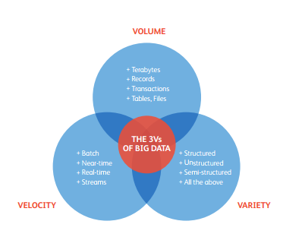
What is data? The “3 V’s”
Volume - Large amounts of data ranging from a many terabytes to a few petabytes.
Variety - Data that is organized in multiple structures.
Velocity - The speed at which data can be processed. The larger your data set, bigger your velocity challenge.
Notes:
The data can be described with these three words

Slide 4

Relatable Analogy
Let’s say you’re given two assignments every 5 days
It takes you to complete one assignment every 5 days
You continuously receive two more assignments every 5 days
Eventually there’s so much work that you can’t complete them all in time
This is the Enterprise Approach...
Notes:
With this example in mind, there’s three different words that describe big data, the amount of assignments you get, the type, and how fast you complete

Slide 5
How do we solve this problem?
With data continuously entering the computer, there’s two main approaches:
Enterprise Approach - Big Data is processed by a powerful computer. Eventually, the computer gets to a limit where the amount of data gets too large. Then the work starts piling up.
Hadoop’s Approach - Big Data is broken into multiple pieces. The cluster of computers compute each computation then combines them into a single result.
Back to the analogy...
Notes:
Bring it back to the analogy and talk about the more efficient method from analogy slide.

Slide 6
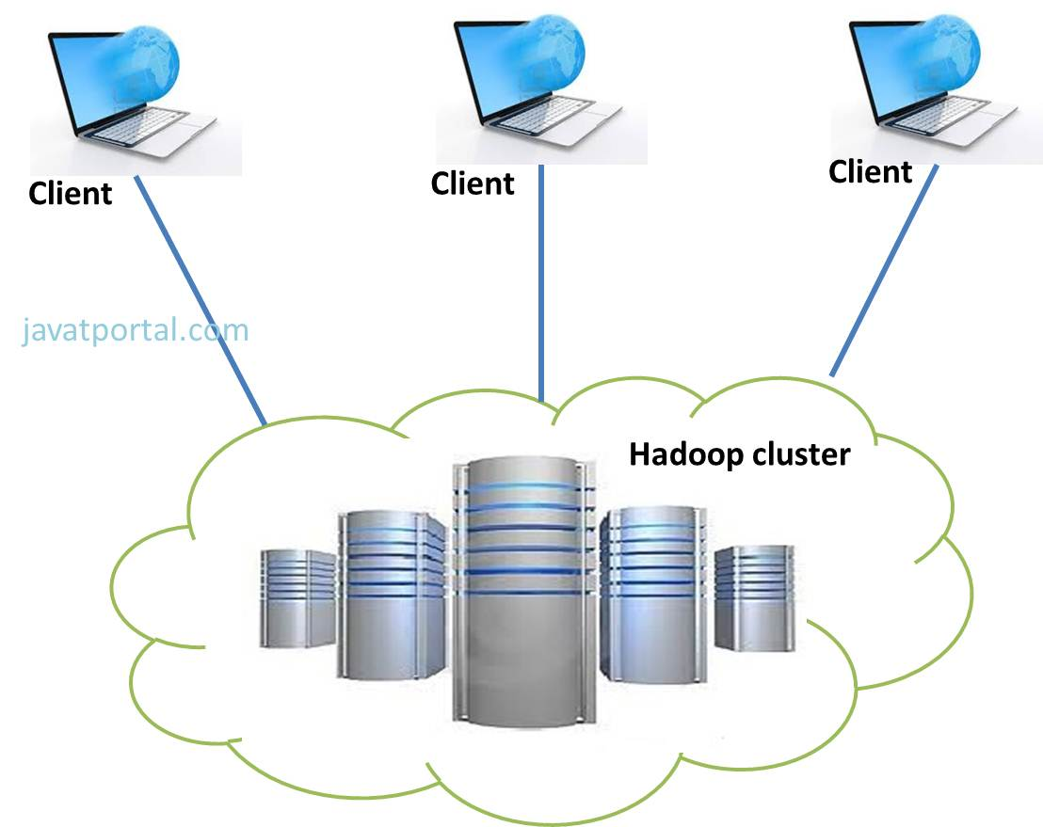
What is Hadoop Exactly?
Hadoop is a linux based set of tools.
Hadoop works on a distributed model with numerous low cost computers.
Each low cost computer, called slaves, has two components: a task tracker and a data node.
The task tracker processes the piece of data given to this particular node.
Notes:
Keep this short

Slide 7

So, why Hadoop?
By dividing the load, the massive amount of inputted data can be parallel processed by each slave. This significantly speeds up processing time.
Hadoop brings the computation to the data.
Hadoop is highly scalable. It can go up from one computer to thousands and the processing speed is linear to the number of computers.

Slide 8
HDFS (Hadoop Distributed File System)
HDFS is what allows Hadoop to store large amounts of data.
It contains the following
NameNode - This runs on the “master node”. It also tracks and controls storage of the clusters.
DataNode - Runs on the “slave nodes”. It replicates the data files three times and stores it across the cluster.
Client Machine - In charge of uploading data, submitting Mapreduce jobs, and viewing processed data
Notes:
IDK how to do this one, the executable part is right, idk about the first bullet point

Slide 9
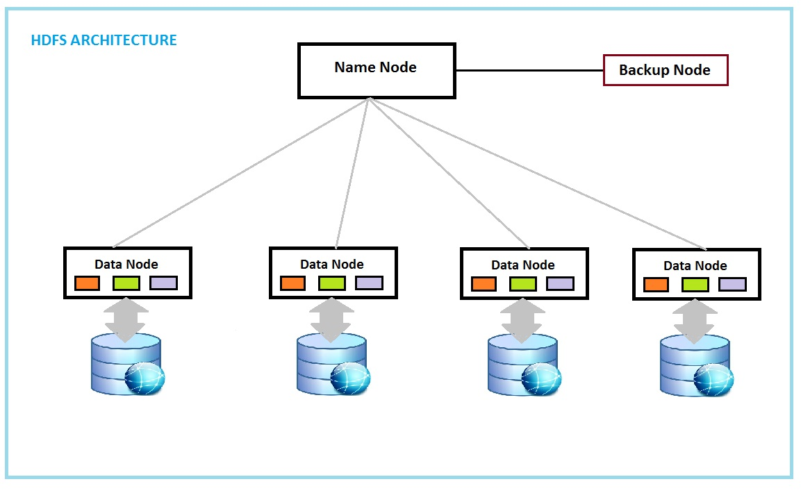
Part of a Bigger Picture

Slide 10
Hadoop Map Reduce (YARN)
Map Phase: Input data is copied and split into a large number of fragments with map tasks. Taken care of by Hadoop’s ecosystem.
Distributing: Map tasks are distributed across cluster of computer units.
Processing: Each unit uses map tasks to process data and create immediate key-value pairs.
Sorting: The pairs are sorted by keys and partitioned into fragments
Reduce Phase: Each unit reduces the data fragments and creates an output key-value pair
Distributing: Reduce tasks are distributed across the cluster.
Processing: The reduce tasks write the outputs to HDFS when finished
Notes:
THIS

Slide 11
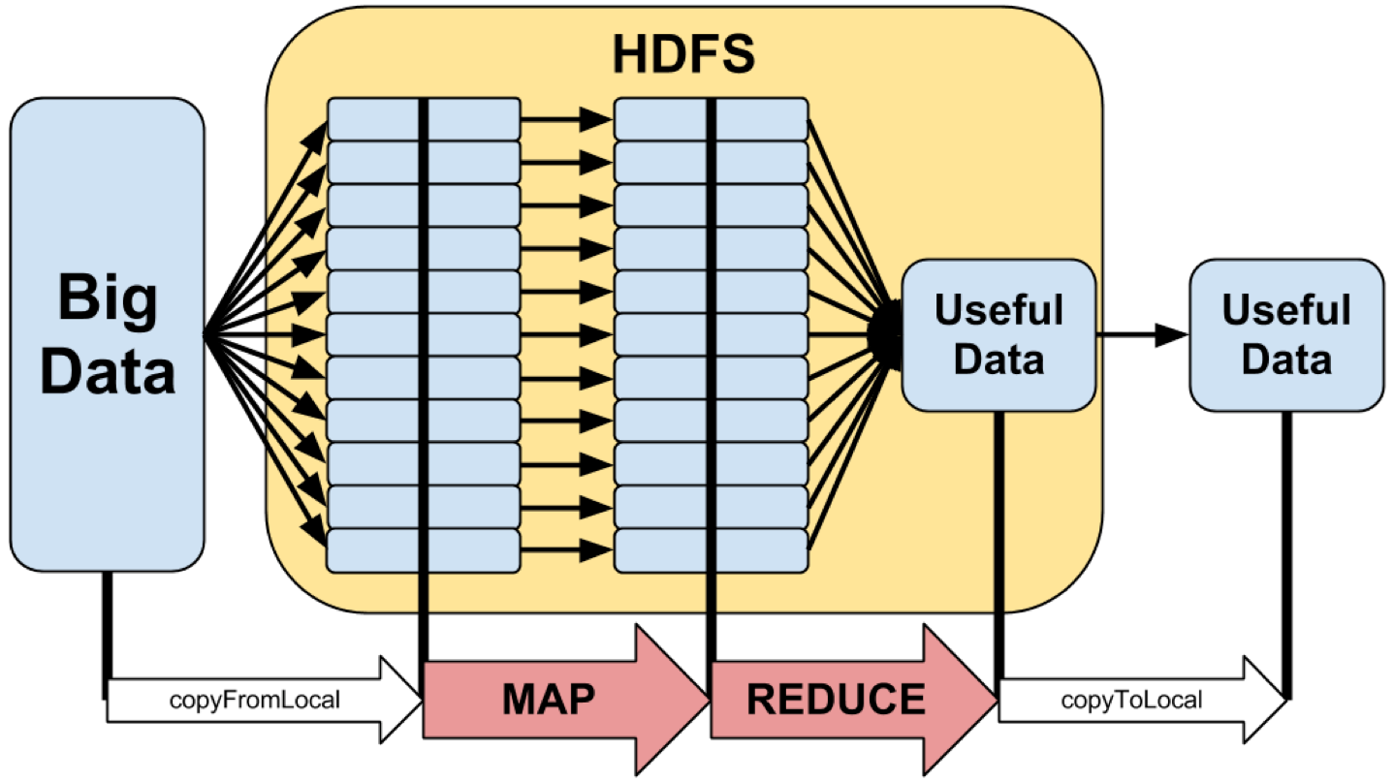
Visualizing the Process
Notes:
The only code we need to worry about is the map task the jobs and the reduce task, everything else is taken care of

Slide 12
Different Flavors of Hadoop
Hbase - Designed to operate on top of the Hadoop distributed file system (HDFS) for scalability, fault tolerance, and high availability.
Written in Java
Open source
Hive - data warehousing application in Hadoop.
Written in HQL (similar to SQL)
Created by facebook, but is now open source
Pig - large-scale data processing system
Written in Pig Latin (similar to Perl)
Created by Yahoo!, but is now open source
Common Idea: Provide high level languages that can be used to for large data processing
Notes:
Talk a little more about pig script since that’s our demonstration

Slide 13
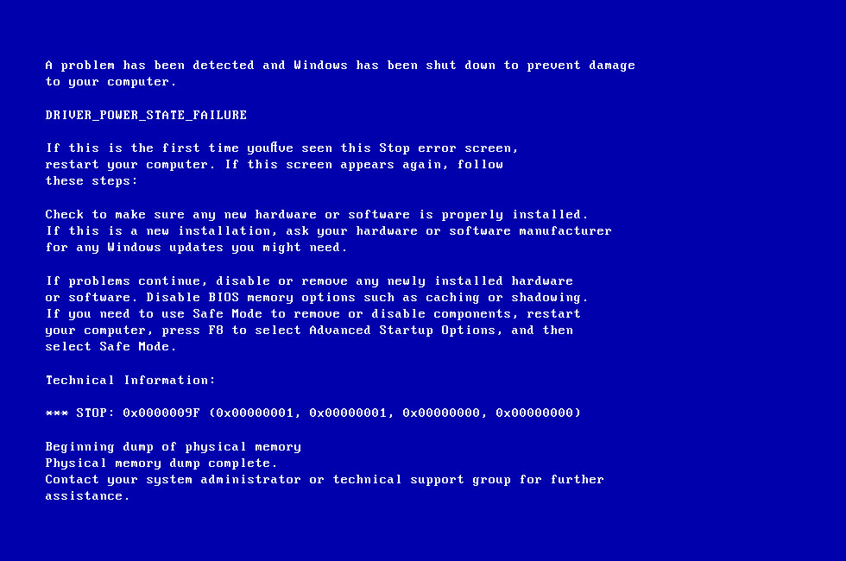
Notes:
So what’s a common aspect across all computers?

Slide 14
Fail Safe Management
To counteract different failures…
Slave Name Node: Hadoop keeps multiple copies of each file and scattered amongst other nodes. When the node is fixed, Hadoop copies the data from the other nodes.
Slave Task Tracker: Master computer tracks the slave’s failure and contact other computers to complete the job. All data is backed up in the master’s name node
Master Computer: If the master computer fails, there’s a second computer called the backup master.
The system must continue against all odds.
Notes:
So.. Let’s talk about a common aspect of computing, Hadoop was built to keep computer failures in mind.

Slide 15
Realistic Application for Hadoop
Logs - commonly referred data about what webpages people have visited and in which order they have visited them.
Logs are tedious to analyze because of its volume.
With Hadoop, you can quickly analyze all this data.
Example, when you’re on amazon
Relevant items - what items are typically bought with other items
If you put something into your cart and you decide you do not want to purchase - final page visited, list in shopping cart, state of transaction
All of this data can be useful when it is collected.

Slide 16
Realistic Application for Hadoop cont.
Credit card fraud
What you usually buy
Where you usually buy
How much you usually spend
This data can be used to determine if a purchase on your card was fraud

Slide 17

Applications
Risk Management: Determine which patients have the highest risk of dying at a hospital, for priority treatment.
Company Image Analysis: Mine social media conversations to analyze what people think about your company.

Slide 18
Where is Hadoop used?
Companies that heavily used it:
Yahoo - Security, they had a presentation a couple weeks back how they use Hadoop for advertisement click fraud or real by detecting uncommon click patterns.
Facebook - Users login data, and various posts across the domain.
Amazon - Sorting merchandise and maintaining purchases from customers
Notes:
THIS

Slide 19
How to Get Started
Cluster Setup Download
http://hortonworks.com/products/sandbox/
VirtualMachine Download (v. 16.04.1 LTS)
https://www.ubuntu.com/download/desktop
After installation, click on new
Set any name, pick type: linux, version: ubuntu (64bit)

Slide 20
Content/Resources/Reference
https://www.youtube.com/watch?v=xWgdny19yQ4, https://www.youtube.com/watch?v=Pq3OyQO-l3E, https://www.youtube.com/watch?v=DLutRT6K2rM (Introductory Concept Videos)
http://www.glennklockwood.com/data-intensive/hadoop/overview.html (Overview Map Reduce & Hadoop)
https://hadoop.apache.org/docs/stable/hadoop-mapreduce-client/hadoop-mapreduce-client-core/MapReduceTutorial.html (Hadoop Tutorial)
http://www.plottingsuccess.com/hadoop-101-important-terms-explained-0314/
Hadoop For Dummies (book)

